Slide 1
Feature selection

Slide 2
Pipeline
1. remove missing values
2. scaling - minmax
3. variance threshold
4. correlation threshold
5. random forest
6. PCA

Slide 3

Scaling
MinMax scaler - MinMaxScaler rescales the dataset such that all feature values are in the range [0, 1].

Slide 4
Variance threshold
After minmax standardization
Threshold – 0.05
Features with lower than threshold removed
None removed

Slide 5
Correlation threshold
Pearson correlation.
Threshold – 0.7
More then 0.7 corr removed
Left – 42 features (so many are correlated)

Slide 6
Feature importance – extra tree classifier
These techniques try to combine the benefits of the other two
methods by leveraging Machine Learning models themselves to rank and score
feature variables based on their importance
An “extra trees” classifier, otherwise known as an “Extremely randomized trees” classifier, is a variant of a random forest. Unlike a random forest, at each step the entire sample is used and decision boundaries are picked at random, rather than the best one.

Slide 7
Our feature importance
Results – removed how many we asked for
the feature importances (the higher, the more important the feature)
0.004654558404558435 trials_ratio_N_DN2_est_std
0.023504426444489808 trials_ratio_N_DN2_est_phase
0.014089151589151588 trials_ratio_N_DN2_est_mean
…
0.02122007280159454 sum_fixation_length_All
0.046531480187709105 amount_of_first_fixations_on_threat
0.02476171039100824 amount_of_first_fixations_on_neutral
0.04616910072707583 normalized_mean_pupil_size_Neutral
0.020067312767179532 normalized_mean_pupil_size_WS
0.03644010118672833 STD_pupil_size_Disgusted

Slide 8
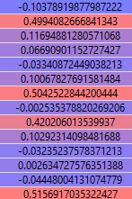
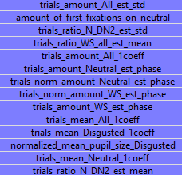
Principal Components Analysis
Our PCA

Slide 9
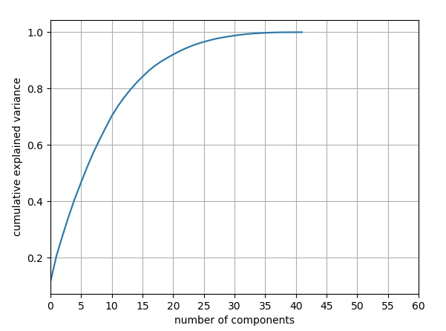
Mutual information

